Slide 1
Python

Slide 2

Index
Python
• Regular Expression
• Regular Expression Syntax:
• w+ and ^ Expression
• \s expression in re.split function
• regular expression methods
• Python Flags

Slide 3
Regular Expression
A regular expression in a programming language is a special text string used for describing a search pattern.
It is extremely useful for extracting information from text such as code, files, log, spreadsheets or even documents.
While using the regular expression the first thing is to recognize is that everything is essentially a character, and we are writing patterns to match a specific sequence of characters also referred as string.
Ascii or latin letters are those that are on your keyboards and Unicode is used to match the foreign text.
It includes digits and punctuation and all special characters like $#@!%, etc.

Slide 4
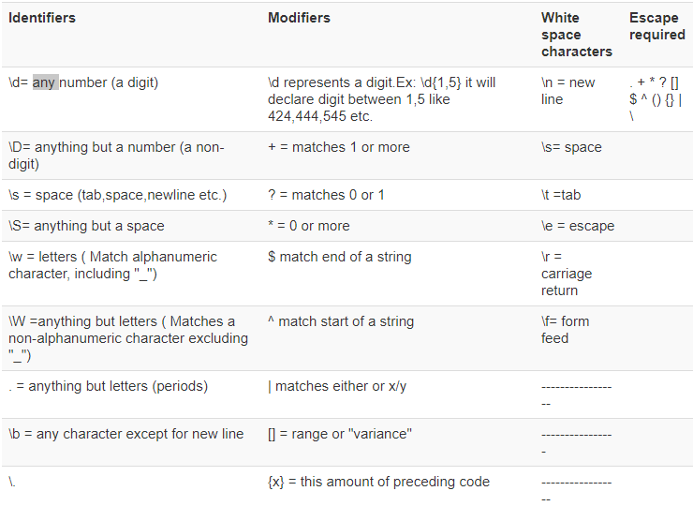
Regular Expression
In Python, a regular expression is denoted as RE (REs, regexes or regex pattern) are imported through re module. Python supports regular expression through libraries. In Python regular expression supports various things like Modifiers, Identifiers, and White space characters.

Slide 5
Regular Expression
Regular Expression Syntax:
RE:
"re" module included with Python primarily used for string searching and manipulation.
Also used frequently for web page "Scraping“.
Example of w+ and ^ Expression:
"^": This expression matches the start of a string.
"w+": This expression matches the alphanumeric character in the string.
Here we will see an example of how we can use w+ and ^ expression in our code

Slide 6




Regular Expression
For example, for our string “digitallync111, education" if we execute the code with w+ and^, it will give the output " digitallync111 ".
Remember, if you remove +sign from the w+, the output will change, and it will only give the first character of the first letter, i.e., [d]

Slide 7




Regular Expression
Example of \s expression in re.split function:
"s": This expression is used for creating a space in the string.
To understand how this regular expression works in Python, we begin with a simple example of a split function. In the example, we have split each word using the "re.split" function and at the same time we have used expression \s that allows to parse each word in the string separately.
Now, let see what happens if you remove "\" from s. There is no 's' alphabet in the output, this is because we have removed '\' from the string, and it evaluates "s" as a regular character and thus split the words wherever it finds "s" in the string.
Similarly, there are series of other regular expressions in Python that you can use in various ways in Python like \d,\D,$,\.,\b, etc.

Slide 8
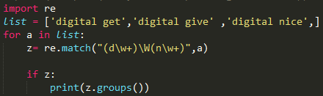

Regular Expression
Using regular expression methods:
The "re" package provides several methods to actually perform queries on an input string. The method we going to see are
re.match()
re.search()
re.findall()
re.match():
The match function is used to match the RE pattern to string with optional flags. In this method, the expression "w+" and "\W" will match the words starting with letter ‘d' and thereafter, anything which is not started with ‘d' is not identified. To check match for each element in the list or string, we run the forloop.

Slide 9
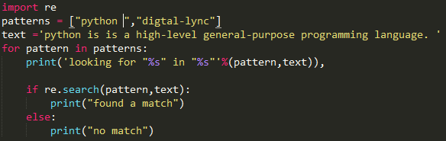

Regular Expression
re.search():
A regular expression is commonly used to search for a pattern in a text.
This method takes a regular expression pattern and a string and searches for that pattern with the string.
In order to use search() function, you need to import re first and then execute the code.
The search() function takes the "pattern" and "text" to scan from our main string and returns a match object when the pattern is found or else not match if the pattern is not found.

Slide 10
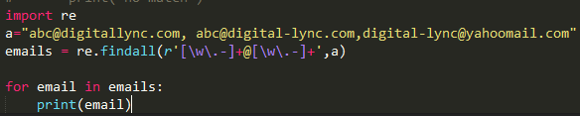

Regular Expression
re.findall():
Re.findall() module is used when you want to iterate over the lines of the file, it will return a list of all the matches in a single step.
For example, here we have a list of e-mail addresses, and we want all the e-mail addresses to be fetched out from the list, we use the re.findall method. It will find all the e-mail addresses from the list.

Slide 11
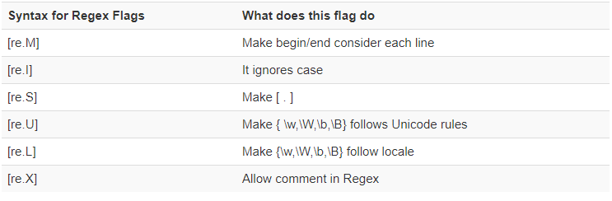
Regular Expression
Python Flags:
Many Python Regex Methods and Regex functions take an optional argument called Flags. This flags can modify the meaning of the given Regex pattern. To understand these we will see one or two example of these Flags.
Various flags used in Python

Slide 12
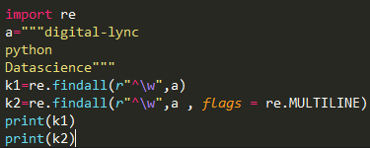

Regular Expression
Example of re.M or Multiline Flags:
In multiline the pattern character [^] match the first character of the string and the beginning of each line (following immediately after the each newline).
While expression small "w" is used to mark the space with characters. When you run the code the first variable "k1" only prints out the character ‘d' for word digital-lync, while when you add multiline flag, it fetches out first characters of all the elements in the string.

